Slide 1


Faculty of Foreign Languages
and Area Studies of Lomonosov Moscow State University
Would you like to teach foreign languages?
Do you want to become an interpreter or a translator?
Or, maybe, you want to become a specialist in Russian studies?

Slide 2
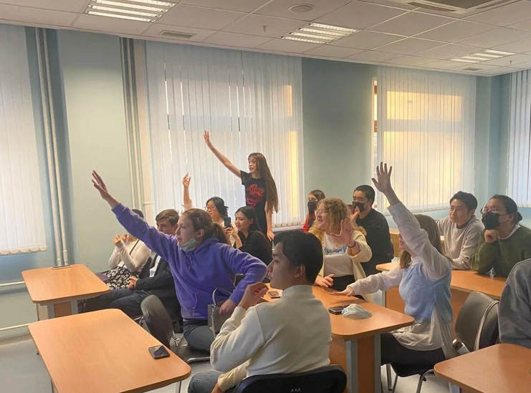
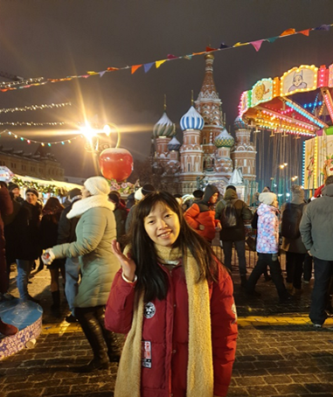
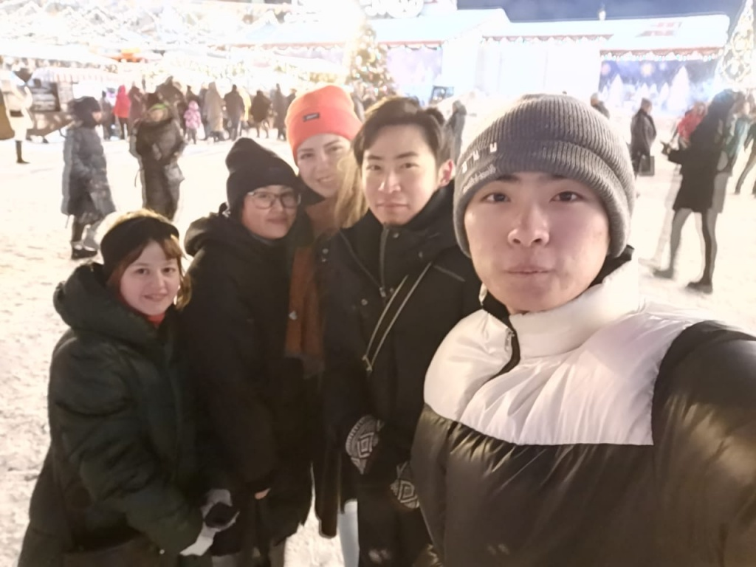
Faculty of Foreign Languages
and Area Studies of Lomonosov Moscow State University
Have you ever dreamed of an exciting student life?

Slide 3
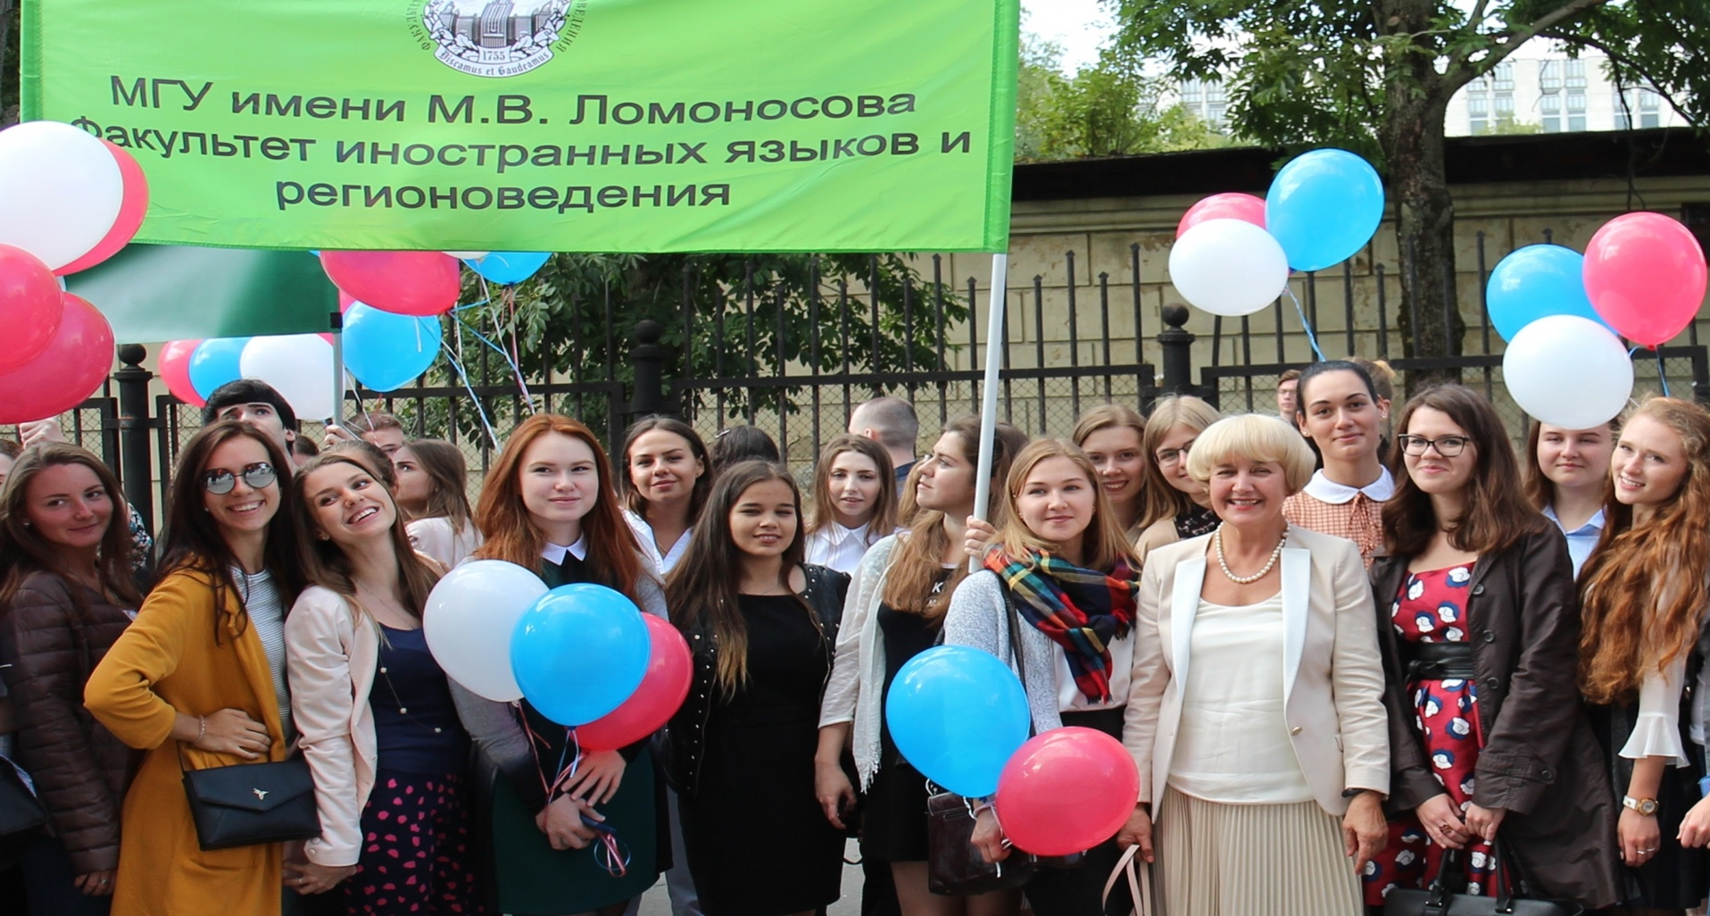
Then welcome to FFLAS!

Slide 4
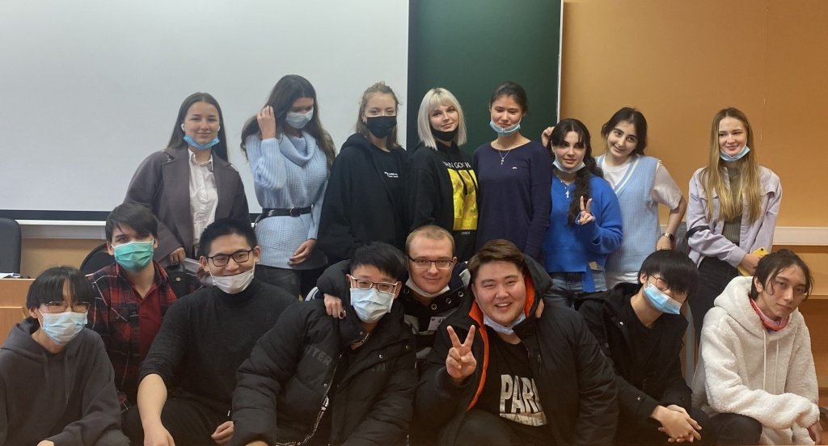
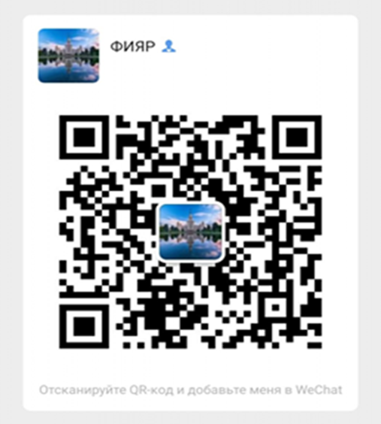
Faculty of Foreign Languages
and Area Studies of Lomonosov Moscow State University
http://ffl.msu.ru
fflas_international_msu@mail.ru

Slide 5


Faculty of Foreign Languages
and Area Studies of Lomonosov Moscow State University
Bachelor’s programs | Linguistics – 100 places for students
1. Translation and intercultural communication
2. Theory and methodology of teaching foreign languages

Slide 6


Faculty of Foreign Languages
and Area Studies of Lomonosov Moscow State University
Bachelor’s programs | Area Studies
1. Russian Area Studies – 5 places for students
2. Foreign Area Studies – 5 places for students
Please note that the level of your Russian language should be at least С1 (Advanced)
2. Зарубежное регионоведение – 5 мест
Уровень русского языка: не ниже С1

Slide 7
Faculty of Foreign Languages
and Area Studies of Lomonosov Moscow State University
ENTRANCE EXAMS
1. Russian language
2. English language
Linguistics
Russian Area Studies,
Foreign Area Studies
1. Russian language
2. History

Slide 8
What will you study?
Faculty of Foreign Languages
and Area Studies of Lomonosov Moscow State University
Russian and English languages
The world of Russian language and culture
The world of English language and culture
History of Russia
The world of Russian language and culture in the context of global civilizations
Russian-English translation
Introduction into the theory of teaching foreign languages
Theory of teaching foreign languages
e.t.c.

Slide 9
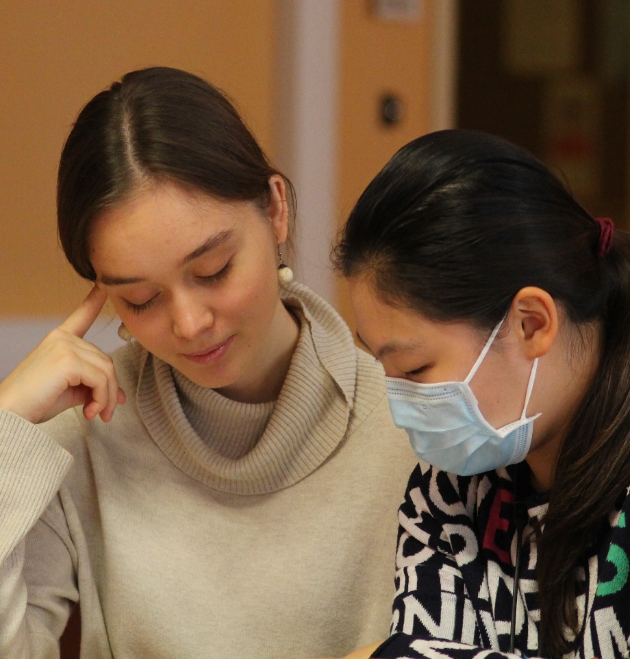
Faculty of Foreign Languages
and Area Studies of Lomonosov Moscow State University
Master’s programs | Linguistics – 50 places for students
1. Russian language
2. Russian and French languages and cultures
Russian language – language of education
French language – 1st foreign language (beginners)
English language – 2nd foreign language (elective course)

Slide 10
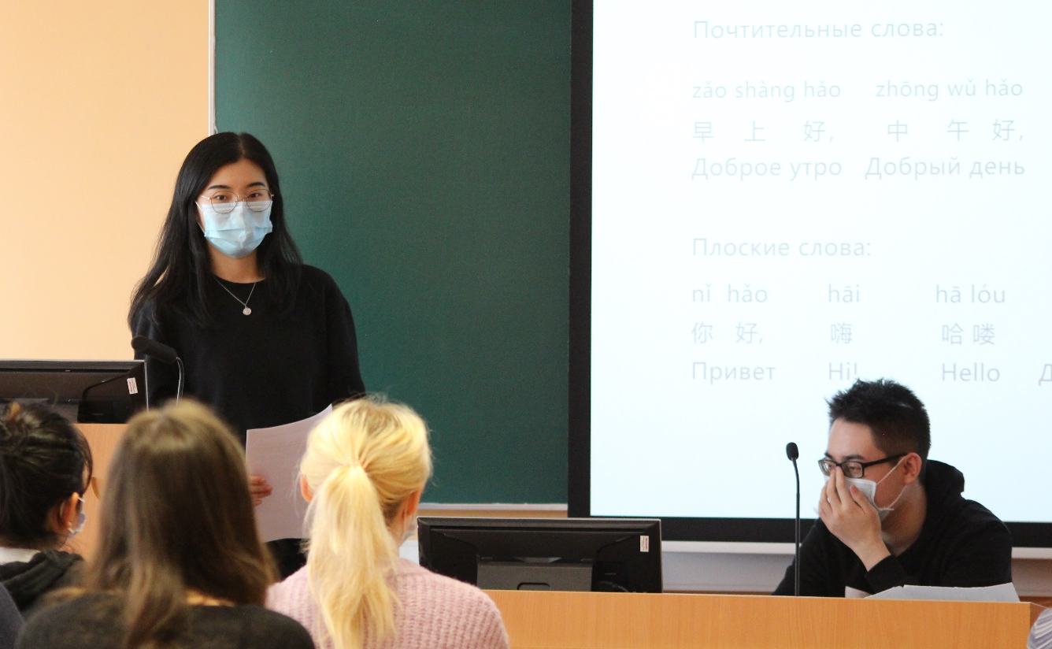
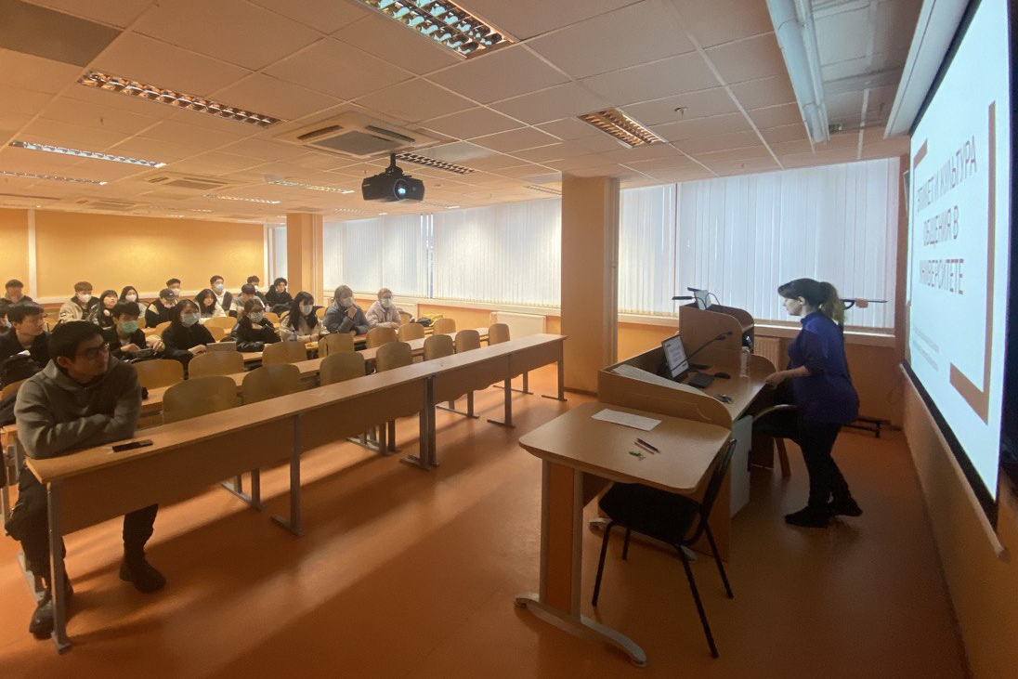
Faculty of Foreign Languages
and Area Studies of Lomonosov Moscow State University
Master’s programs | Russian Area Studies – 10 places for students

Slide 11

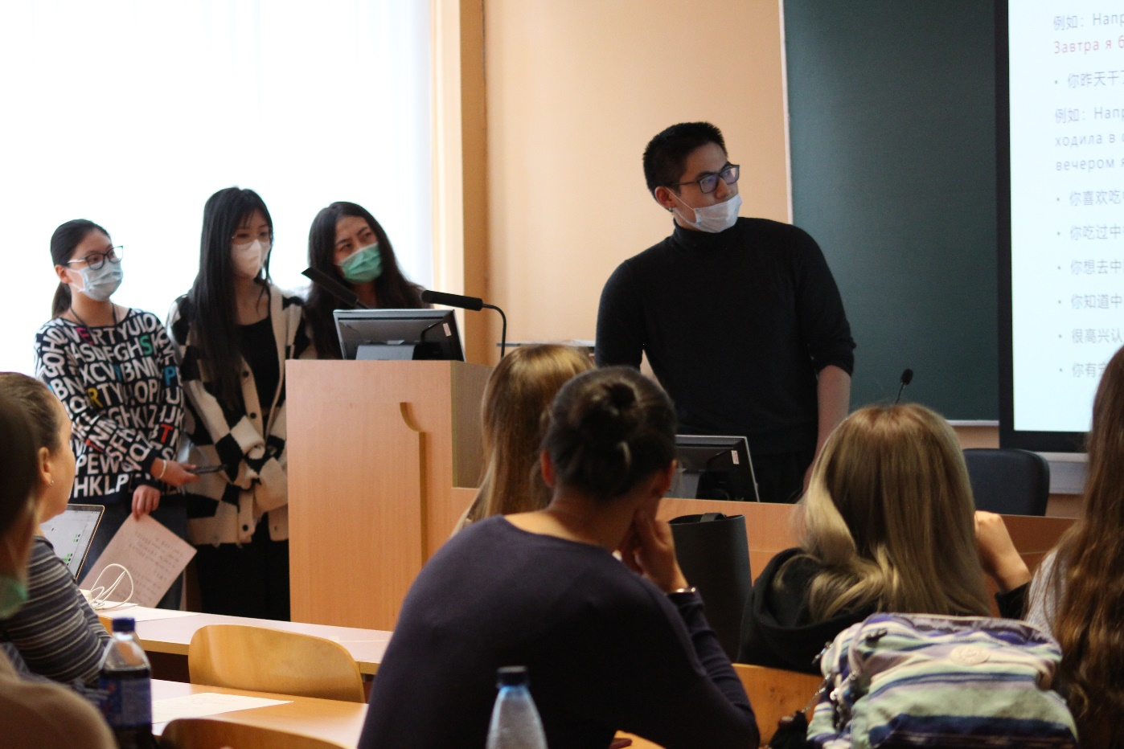
Faculty of Foreign Languages
and Area Studies of Lomonosov Moscow State University
Master’s programs | Culture Studies – 10 places for students

Slide 12
Faculty of Foreign Languages
and Area Studies of Lomonosov Moscow State University
ENTRANCE EXAMS FOR THE MASTER’S PROGRAMS
Linguistics
(written exam)
Linguistics
Russian Area Studies
(written exam)
Russian Area Studies
Culture Studies
(written exam)
Culture Studies

Slide 13
Documents for application
Faculty of Foreign Languages
and Area Studies of Lomonosov Moscow State University
Education documents with a certified translation
Application form (filled out online: webanketa.msu.ru)
Passport / ID with a certified translation
Visa and migration card
Health insurance issued in Russia
A scan of a visa-format photograph (in good quality)

Slide 14

Faculty of Foreign Languages
and Area Studies of Lomonosov Moscow State University

Slide 15
Faculty of Foreign Languages
and Area Studies of Lomonosov Moscow State University
Tuition fee in 2022
Bachelor’s programs
420 000 rubles per year
Master’s programs
430 000 rubles per year

Slide 16
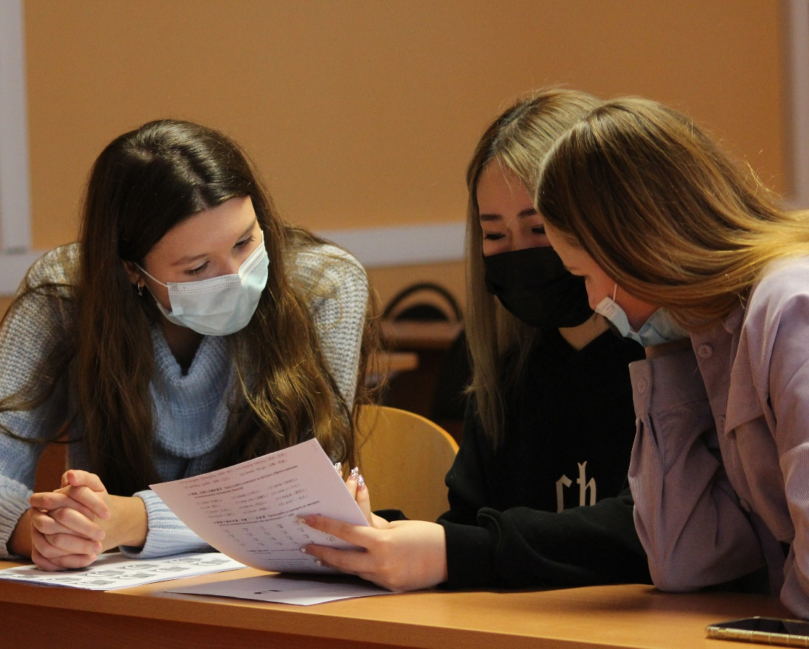
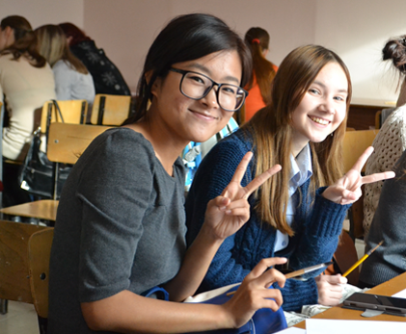
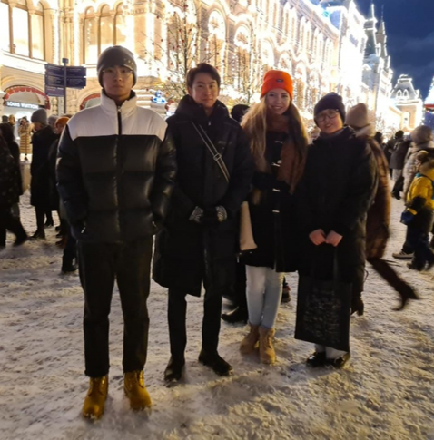
Faculty of Foreign Languages
and Area Studies of Lomonosov Moscow State University
We study, work and have fun together!

Slide 17

Faculty of Foreign Languages
and Area Studies of Lomonosov Moscow State University
FFLAS –
your choice, your future!

Slide 18

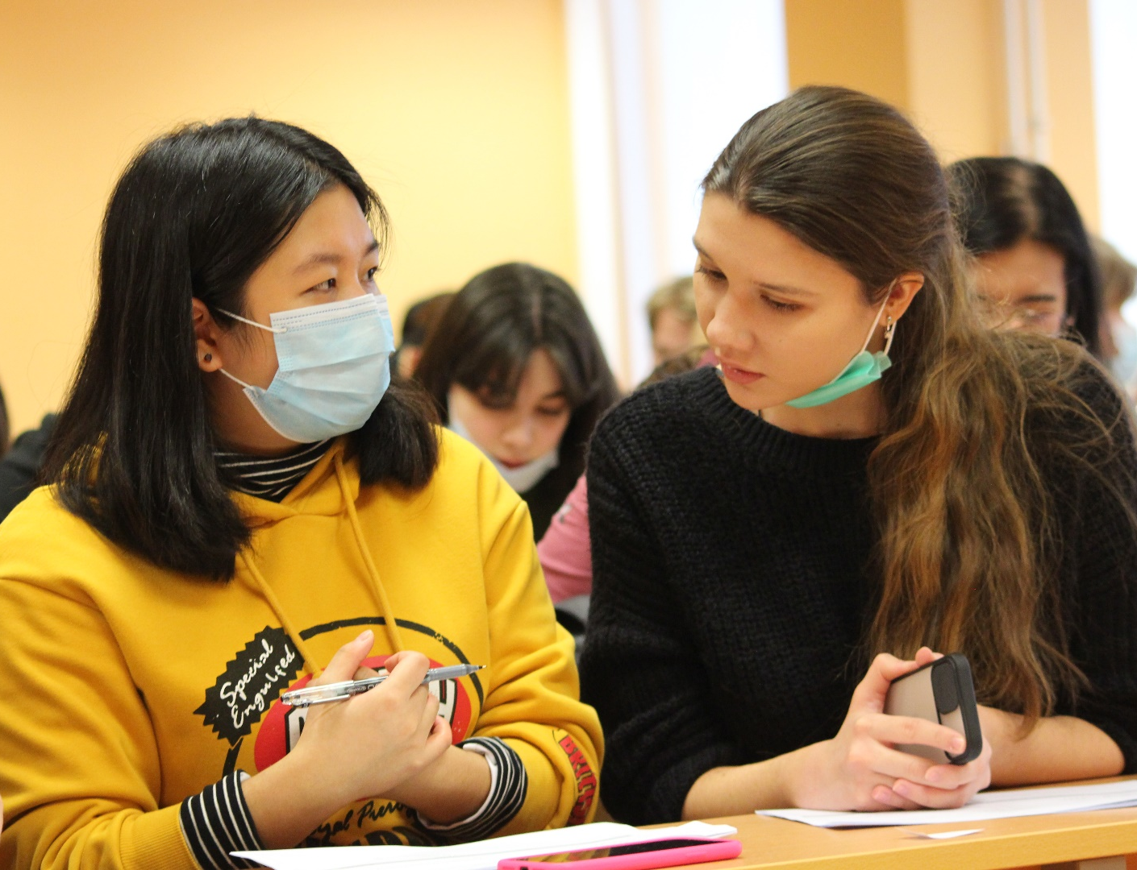
Faculty of Foreign Languages
and Area Studies of Lomonosov Moscow State University
See you soon!

